Slide 1
The Computer Security Environment Today

Slide 2
Objectives
Discuss what threats we see today
Explain how vulnerable we really are
Discuss the hope we have in battling risk

Slide 3
Where We Are Today
We are always connected
We have at least 2 devices that receive internet close to you right now
We have apps for everything!
We bank online
We watch TV online
We pay our taxes online
We communicate with others online

Slide 4
The Devices We Have…
We use smart phones
We use smart watches
We use smart cars
We use smart TVs
All these assets are connected. They are all online.
All devices and the way we use them have the potential to become vulnerable in some way.

Slide 5
Within The Past Week…
Within the past week I have:
Been sent phishing emails
Received calls from “Microsoft” saying that I have a virus on my computer
Seen someone in the data center that I didn’t know who they were, but they had credentials
Had to deal with a security incident in which student data may have been accessed – it wasn’t.
Fixed bugs in a system
Learned how to increase security in some way

Slide 6
So WHAT?
The point I’m trying to make is that computer security is every bit a part of who we are
We all have devices that need protecting
We all have information that needs to be protected
There are threats out there that we may encounter

Slide 7
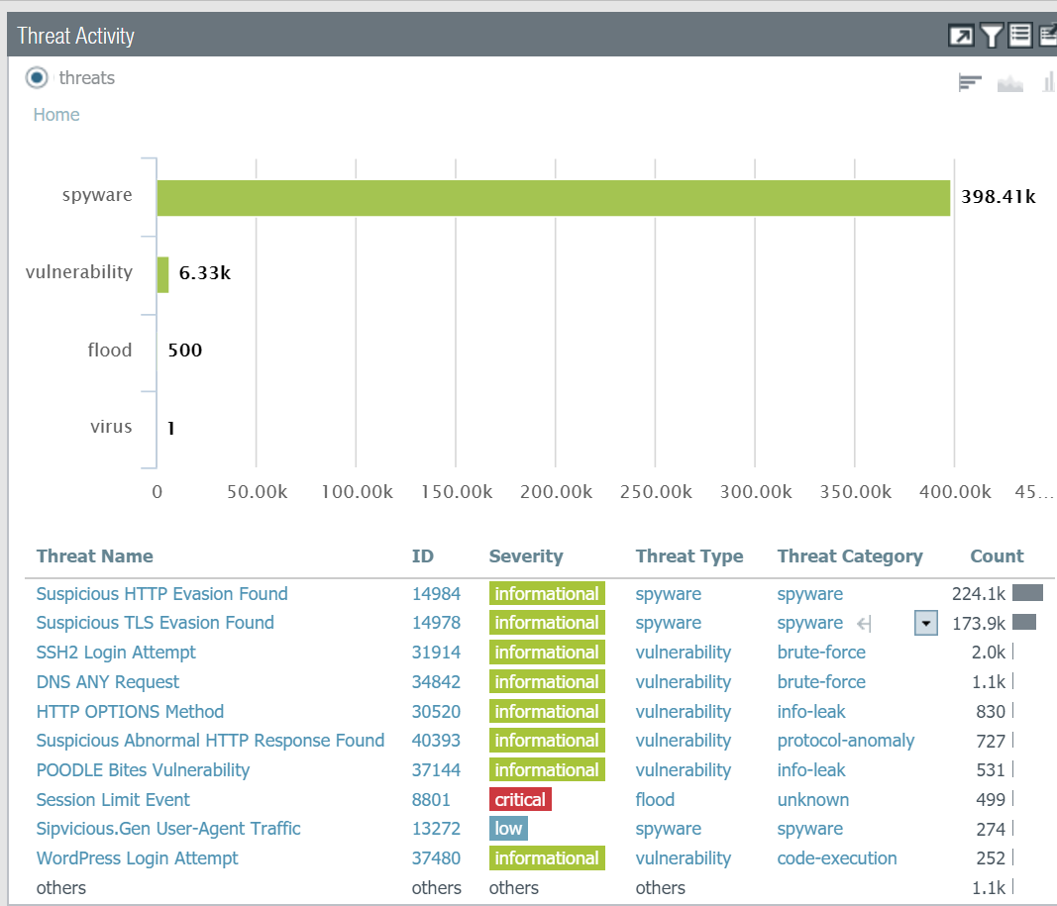
What’s on my radar today?
These are the firewall hits.
In the middle of the summer.
Without students.
For a one hour time period!

Slide 8
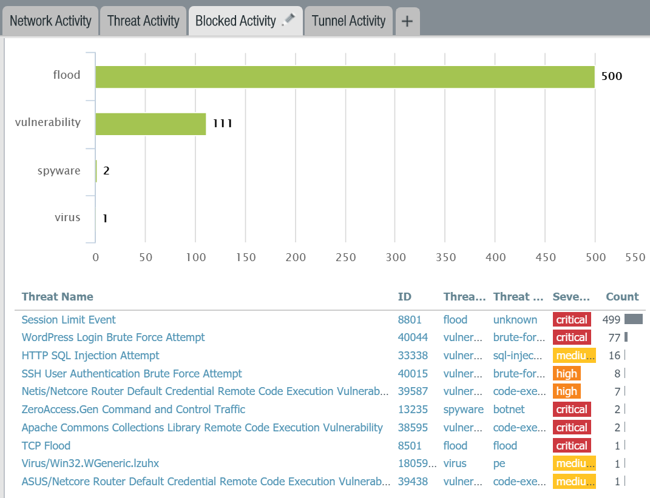
Perhaps these aren’t as serious or are they?
Once again, only 1 hour time period!
Maybe we should investigate these…

Slide 9
The Challenges
Computer security is not simple. It takes time to understand. You have to learn both theory and learn through example.
When deploying services or systems, there are always going to be vulnerabilities. How can you account for them when the system is being designed or implemented
It is necessary to balance security with practicality and productivity
Security is a constant battle against those who want to do harm
Information is everywhere – knowing when to use it and not use it or how to protect it is a full time job
The security field is so hot right now it’s difficult to keep good people

Slide 10
There is HOPE!
First, you taking this course to learn about the practical side of security
Second, the security field has near 0% unemployment. We need the best and the brightest to fight the adversaries out there
Software and tools are becoming better at mitigation
We must remain vigilant!

